Slide 1





Functions and Triggers
User-defined Functions, Procedures, Triggers and Transactions
Databases
Basics
SoftUni Team
Technical Trainers
Software University
http://softuni.bg
Notes:
© Software University Foundation – http://softuni.org
This work is licensed under the Creative Commons Attribution-NonCommercial-ShareAlike license.
<number>

Slide 2




Table of Contents
Functions
Transactions
Procedures
Triggers
<number>
Notes:
© Software University Foundation – http://softuni.org
This work is licensed under the Creative Commons Attribution-NonCommercial-ShareAlike license.
<number>

Slide 3
Questions
sli.do #MYSQL
<number>

Slide 4


User-Defined Functions
Notes:
*
(c) 2007 National Academy for Software Development - http://academy.devbg.org. All rights reserved. Unauthorized copying or re-distribution is strictly prohibited.*
<number>##

Slide 5

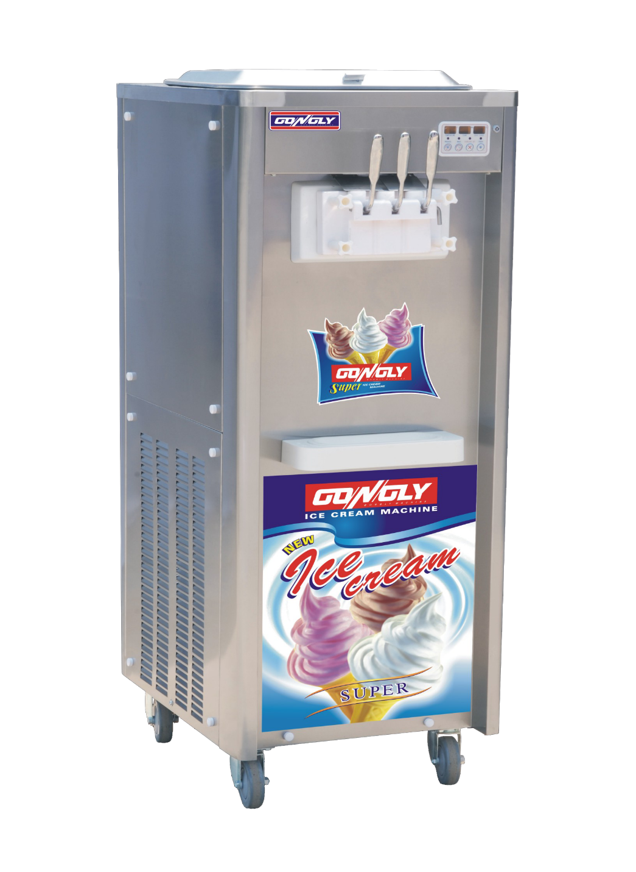





Functions Basics
<number>
Notes:
© Software University Foundation – http://softuni.org
This work is licensed under the Creative Commons Attribution-NonCommercial-ShareAlike license.
<number>

Slide 6
User-Defined Functions
Always returns a value
Can accept parameters
Can be nested
<number>

Slide 7
Create Functions
Function Name
DELIMITER $$
CREATE FUNCTION udf_project_weeks (start_date DATETIME, end_date DATETIME)
RETURNS INT
BEGIN
DECLARE project_weeks INT;
IF(end_date IS NULL) THEN
SET end_date := NOW();
END IF;
SET project_weeks := DATEDIFF(DATE(end_date), DATE(start_date)) / 7;
RETURN project_weeks;
END $$
Variable
Parameters
IF Statement
Return result
<number>
Notes:
© Software University Foundation – http://softuni.org
This work is licensed under the Creative Commons Attribution-NonCommercial-ShareAlike license.
<number>

Slide 8
Execute Functions
Call function
SELECT p.project_id,
DATE(p.start_date) AS 'start_date',
DATE(p.end_date) AS 'end_date',
udf_project_weeks(p.start_date, p.end_date) AS 'project_weeks'
FROM projects AS p;
project_id | start_date | end_date | project_weeks
1 | 2003-06-01 | NULL | 732
2 | 2001-06-01 | 2003-06-01 | 104
3 | 2002-06-01 | 2003-06-01 | 52
<number>
Notes:
© Software University Foundation – http://softuni.org
This work is licensed under the Creative Commons Attribution-NonCommercial-ShareAlike license.
<number>

Slide 9
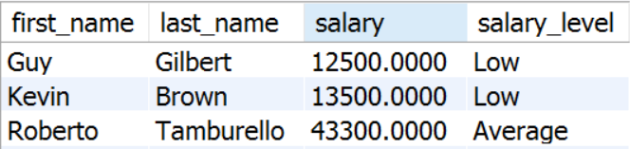

Problem: Salary Level Function
Write a function udf_get_salary_level(salary DECIMAL(19,4)) that receives salary of an employee and returns the level of the salary.
If salary is < 30000 return "Low"
If salary is between 30000 and 50000 (inclusive) return "Average"
If salary is > 50000 return "High"
Check your solution here: https://judge.softuni.bg/Contests/Practice/Index/302#4
<number>
Notes:
<number>##

Slide 10
Solution: Salary Level Function (1)
Function Name
Input Parameters
CREATE FUNCTION udf_get_salary_level(salary DECIMAL(19,4))
RETURNS VARCHAR(10)
BEGIN
-- Function logic here.
END;
Return Type
Function Body
Check your solution here: https://judge.softuni.bg/Contests/Practice/Index/298#4
<number>
Notes:
<number>##

Slide 11
Solution: Salary Level Function (2)
Variable
DECLARE salary_level VARCHAR(10); IF (salary < 30000) THEN
SET salary_level := 'Low';
ELSE IF(salary >= 30000 AND salary <= 50000) THEN
SET salary_level := 'Average';
ELSE
SET salary_level := 'High'; END IF;
RETURN salary_level;
IF Statement
Return Result
Check your solution here: https://judge.softuni.bg/Contests/Practice/Index/298#4
<number>
Notes:
<number>##

Slide 12
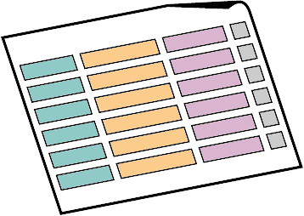


What is a Transaction?

Slide 13
Transactions
Transaction is a sequence of actions (database operations) executed as a whole:
Either all of them complete successfully or none of the them
Example of transaction:
A bank transfer from one account into another (withdrawal + deposit)
If either the withdrawal or the deposit fails the whole operation is cancelled
<number>

Slide 14
Transactions: Lifecycle (Rollback)
Read
Write
Durable starting state
Sequence of reads and writes
Durable,
consistent,
ending state
Write
Rollback
<number>
Notes:
© Software University Foundation – http://softuni.org
This work is licensed under the Creative Commons Attribution-NonCommercial-ShareAlike license.
<number>

Slide 15
Transactions: Lifecycle (Commit)
Read
Write
Durable starting state
Sequence of reads and writes
Durable,
consistent,
ending state
Write
Commit
<number>
Notes:
© Software University Foundation – http://softuni.org
This work is licensed under the Creative Commons Attribution-NonCommercial-ShareAlike license.
<number>

Slide 16
Transactions Behavior
Transactions guarantee the consistency and the integrity of the database.
All changes in a transaction are temporary.
Changes are persisted when COMMIT is executed.
At any time all changes can be canceled by ROLLBACK.
All of the operations are executed as a whole.
<number>
Notes:
© Software University Foundation – http://softuni.org
This work is licensed under the Creative Commons Attribution-NonCommercial-ShareAlike license.
<number>

Slide 17


Checkpoints in games
DIE
Castle 1-1
Castle 1-2
Mario
SURVIVE
<number>
Notes:
© Software University Foundation – http://softuni.org
This work is licensed under the Creative Commons Attribution-NonCommercial-ShareAlike license.
<number>

Slide 18

What are Transactions?
ROLLBACK
STATE 1
STATE 2
COMMIT
Queries
<number>
Notes:
Transaction is a sequence of actions (database operations) executed as a whole:
Either all of them complete successfully
Or none of the them
Example of transaction:
A bank transfer from one account into another (withdrawal + deposit)
If either the withdrawal or the deposit fails the whole operation is cancelled
© Software University Foundation – http://softuni.org
This work is licensed under the Creative Commons Attribution-NonCommercial-ShareAlike license.
<number>

Slide 19
Transactions Syntax
Start Transaction
START TRANSACTION
BEGIN
UPDATE accounts SET balance = balance – withdraw_amount
WHERE id = account
IF ROW_COUNT() <> 1 THEN -- Affected rows are different than one.
SIGNAL SQLSTATE '45000' SET MESSAGE_TEXT = 'Invalid account';
ROLLBACK;
ELSE
COMMIT;
END IF;
Withdraw Money
Undo Changes
Save Changes
<number>
Notes:
Start a transaction
BEGIN TRANSACTION
Some RDBMS use implicit start, e.g. Oracle
Ending a transaction
COMMIT
Complete a successful transaction and persist all changes made
ROLLBACK
“Undo” changes from an aborted transaction
May be done automatically when failure occurs
© Software University Foundation – http://softuni.org
This work is licensed under the Creative Commons Attribution-NonCommercial-ShareAlike license.
<number>

Slide 20


Transactions Properties
Modern DBMS servers have built-in transaction support.
Implement “ACID” transactions.
E.g. Oracle, MySQL, MS SQL Server, …
ACID means:
Atomicity
Consistency
Isolation
Durability
<number>

Slide 21

Stored Procedures
Notes:
*
(c) 2007 National Academy for Software Development - http://academy.devbg.org. All rights reserved. Unauthorized copying or re-distribution is strictly prohibited.*
<number>##

Slide 22
What are Stored Procedures?
Stored procedures
Encapsulate repetitive program logic.
Can accept input parameters.
Can return output results.
Benefits of stored procedures.
Share application logic.
Improved performance.
Reduced network traffic.
<number>

Slide 23
Creating Stored Procedures
CREATE PROCEDURE
Example:
Procedure Name
DELIMITER $$
CREATE PROCEDURE usp_select_employees_by_seniority()
BEGIN
SELECT *
FROM employees
WHERE ROUND((DATEDIFF(NOW(), hire_date) / 365.4)) < 15;
END $$
Procedure Logic
<number>

Slide 24
Executing Stored Procedures
Executing a stored procedure by CALL.
CALL usp_select_employees_by_seniority();
<number>

Slide 25
Dropping Stored Procedures
DROP PROCEDURE
DROP PROCEDURE usp_select_employees_by_seniority();
<number>

Slide 26

Stored Procedures
Using Parameters
Notes:
*
(c) 2007 National Academy for Software Development - http://academy.devbg.org. All rights reserved. Unauthorized copying or re-distribution is strictly prohibited.*
<number>##

Slide 27
Defining Parameterized Procedures
To define a parameterized procedure use the syntax:
CREATE PROCEDURE usp_procedure_name
(parameter_1_name parameter_type,
parameter_2_name parameter_type,…)
<number>

Slide 28
Parameterized Stored Procedures – Example
Procedure Name
DELIMITER $$
CREATE PROCEDURE usp_select_employees_by_seniority(min_years_at_work INT)
BEGIN
SELECT first_name, last_name, hire_date,
ROUND(DATEDIFF(NOW(),DATE(hire_date)) / 365.4,0) AS 'years'
FROM employees
WHERE ROUND(DATEDIFF(NOW(),DATE(hire_date)) / 365.4,0) > min_years_at_work
ORDER BY hire_date;
END $$
CALL usp_select_employees_by_seniority(15);
Procedure Logic
Usage
<number>

Slide 29
Returning Values Using OUTPUT Parameters
CREATE PROCEDURE usp_add_numbers
(first_number INT,
second_number INT,
OUT result INT)
BEGIN
SET result = first_number + second_number
END $$
DELIMITER ;
SET @answer=0;
CALL usp_add_numbers(5, 6,@answer);
SELECT @answer;
-- 11
Creating procedure
Executing procedure
Display results
<number>

Slide 30

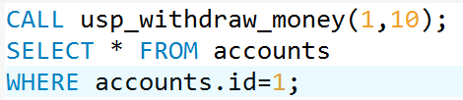
Problem: Withdraw Money
Create a stored procedure usp_withdraw_money (account_id, money_amount) that operate in transactions.
Validate only if the account is existing and if not throw an exception.
Check your solution here: https://judge.softuni.bg/Contests/Practice/Index/298#13
<number>
Notes:
<number>##

Slide 31
Solution: Withdraw Money (1)
Procedure Name
Parameters
CREATE PROCEDURE usp_withdraw_money (account_id INT, money_amount DECIMAL)
BEGIN
-- Transaction logic goes here.
END
Check your solution here: https://judge.softuni.bg/Contests/Practice/Index/298#13
<number>
Notes:
<number>##

Slide 32
Solution: Withdraw Money (2)
BEGIN
START TRANSACTION
UPDATE accounts SET balance = balance – money_amount
WHERE id = account_id;
IF(SELECT COUNT(*) FROM accounts
WHERE id = account_id) <> 1 THEN ROLLBACK;
END IF;
COMMIT;
END $$
Update Balance
Rollback
Save changes
Check your solution here: https://judge.softuni.bg/Contests/Practice/Index/298#13
<number>
Notes:
<number>##

Slide 33

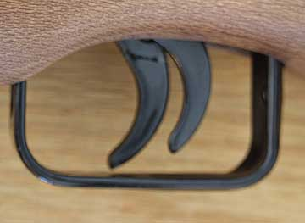
Triggers
Notes:
*
(c) 2007 National Academy for Software Development - http://academy.devbg.org. All rights reserved. Unauthorized copying or re-distribution is strictly prohibited.*
<number>##

Slide 34
What Are Triggers?
Triggers are very much like stored procedures.
Called in case of specific event.
We do not call triggers explicitly.
Triggers are attached to a table.
Triggers are fired when a certain SQL statement is executed against the contents of the table.
E.g. when a new row is inserted in given table.
<number>

Slide 35
MySQL Types of Triggers
Before
After
Trigger
Trigger
Event
Event
<number>
Notes:
There are two types of triggers
After triggers
Before triggers
Key words for getting data inside them are NEW and OLD
© Software University Foundation – http://softuni.org
This work is licensed under the Creative Commons Attribution-NonCommercial-ShareAlike license.
<number>

Slide 36
Events
There are three different events that can be applied within a trigger:
Events
Insert
Update
Delete
<number>
Notes:
© Software University Foundation – http://softuni.org
This work is licensed under the Creative Commons Attribution-NonCommercial-ShareAlike license.
<number>

Slide 37
After Triggers
Trigger Name
DELIMITER $$
CREATE TRIGGER tr_delete_records
AFTER DELETE
ON employees_projects
FOR EACH ROW
BEGIN
INSERT INTO employees_projects_history
(employee_id, project_id)
VALUES(old.employee_id, old.project_id);
END $$
Trigger Type + Event
Table Name
Deleted Data
<number>

Slide 38

Summary
User-defined Functions
Stored Procedures
Triggers
Working with Triggers
Transactions
<number>
Notes:
We can create user defined functions and stored procedures in SQL Server and we can easily execute them to save code repetition.
We can create triggers that apply a given behavior when some condition has occurred.
We can make transactions if we want to be sure that if all the behavior goes as planned, all the changes are made and in the other case, no changes are applied.

Slide 39







Functions, Triggers and Transactions
https://softuni.bg/trainings/
Notes:
© Software University Foundation – http://softuni.org
This work is licensed under the Creative Commons Attribution-NonCommercial-ShareAlike license.
<number>

Slide 40
License
This course (slides, examples, demos, videos, homework, etc.) is licensed under the "Creative Commons Attribution-NonCommercial-ShareAlike 4.0 International" license
Attribution: this work may contain portions from
"Databases" course by Telerik Academy under CC-BY-NC-SA license
<number>
Notes:
© Software University Foundation – http://softuni.org
This work is licensed under the Creative Commons Attribution-NonCommercial-ShareAlike license.
<number>

Slide 41




Free Trainings @ Software University
Software University Foundation – softuni.org
Software University – High-Quality Education, Profession and Job for Software Developers
softuni.bg
Software University @ Facebook
facebook.com/SoftwareUniversity
Software University Forums
forum.softuni.bg
Notes:
© Software University Foundation – http://softuni.org
This work is licensed under the Creative Commons Attribution-NonCommercial-ShareAlike license.
<number>

